Slide 1




NEXT GEN EMPLOYABILITY PROGRAM
Creating a future-ready workforce
Team Members
College Name
Student Name : Sindhiya G
Student ID : au513521104047
Annai Mira College of Engineering and Technology ,Ranipet.

Slide 2

CAPSTONE PROJECT SHOWCASE
Project Title
Building Bus Reservation System using Python and Django
Abstract | Problem Statement | Project Overview | Proposed Solution | Technology Used | Modelling & Results | Conclusion

Slide 3
Abstract
Online Bus Ticket Reservation System is a Web based application that works within a centralized network. This project presents a review on the software program “Online Bus Ticket Reservation System” as should be used in a bus transportation system, a facility which is used to reserve seats, cancellation of reservation and different types of route enquiries used on securing quick reservations.
OBTRS is built for managing and computerizing the traditional database, ticket booking and tracking bus and travel made.
It maintains all customer details, bus details, reservation details. In order to achieve the design, Imo Transport Company (ITC) was chosen as a case study because of its strategic importance to Imo State.
Structured Systems Analysis and Design Methodology (SSADM) was adopted. In addition, PHP Hypertext Preprocessor (PHP) language was used for the front- end of the software while the back end was designed using MySQL. The software achieved is capable of improving the customer hand and relationship management in ITC operations.
It is recommended that despite the present functionality of the designed software, an additional functionality such as the use of E-mail to send tickets and notifications to the customer and an online payment using credit cards/debit cards should be implemented into the system. Furthermore, other operations carried by ITC such as the courier services should also be integrated in order to enhance the system
Source : research gate

Slide 4
Problem Statement
The System that is being used by the staff at the counter currently is an internal system and justused to sell the bus ticket at the counter.
Customer has to go to the counter to buy bus ticket orask for bus schedule. Furthermore, customers need to pay cash when they buy the bus ticket andsometimes needs to queue up long time to get the bus ticket.
Besides that, customer also notallowed to buy bus ticket through telephone and the bus company's telephone has been always- busy line.1.3
Source :

Slide 5
Project Overview
The existing bus ticketing process is plagued by inefficiencies such as manual ticketing, limited seat availability visibility, and cumbersome payment procedures.
Passengers often face challenges in securing tickets, especially during peak travel seasons. Additionally, bus operators struggle to manage bookings and optimize seat utilization efficiently.
These issues result in dissatisfied customers and lost revenue opportunities for bus companies
Source :

Slide 6
Proposed Solution
.
PROPOSED SOLUTION:The solution to this problem is to create an online portal for buying bus ticket system.Customercan buy the bus ticket over the Internet, 24 hours a day, 7daysa week and the busticket can't be lost, stolen or left behind.
In addition, the online system lets the customers check the availability of the bus ticket beforethey buy bus ticket.
Source :

Slide 7
  OBJECTIVES:
The main objectives of the online system include:
To provide a web-based bus ticket buying functions.
Customer can buy bus ticket throughthe online system and no need to queue up to buy bus ticket at the counter.
To enable customer to check the availability of the bus ticket online. Customer cancheck the time departure and arrival for every Transnational’s bus through the system.
To ease the bus ticket payment by online.
Customer has to pay the bus ticket by m-pesamoney services
To reduce the number of staff at the point of sale. The number of staff at the counter can be reduced after the online buying bus ticket system launch
Source :

Slide 8
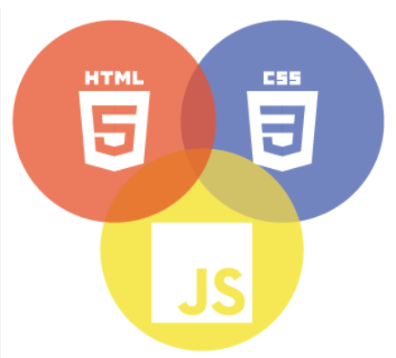

Technology Used
Front-end
Back-end
Source :

Slide 9
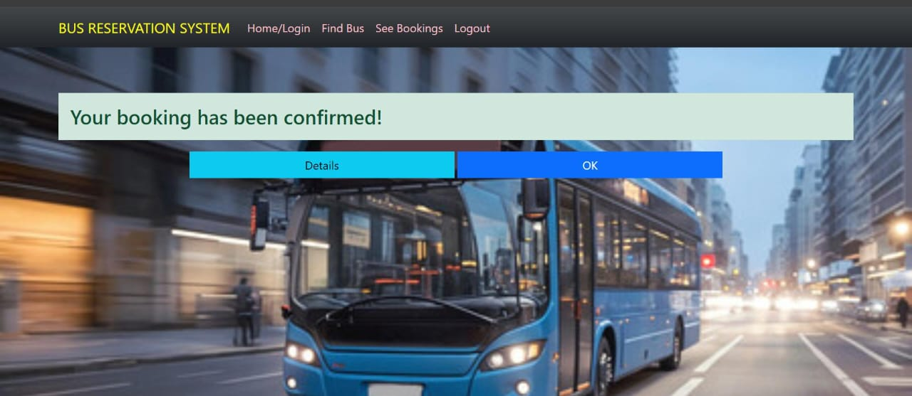
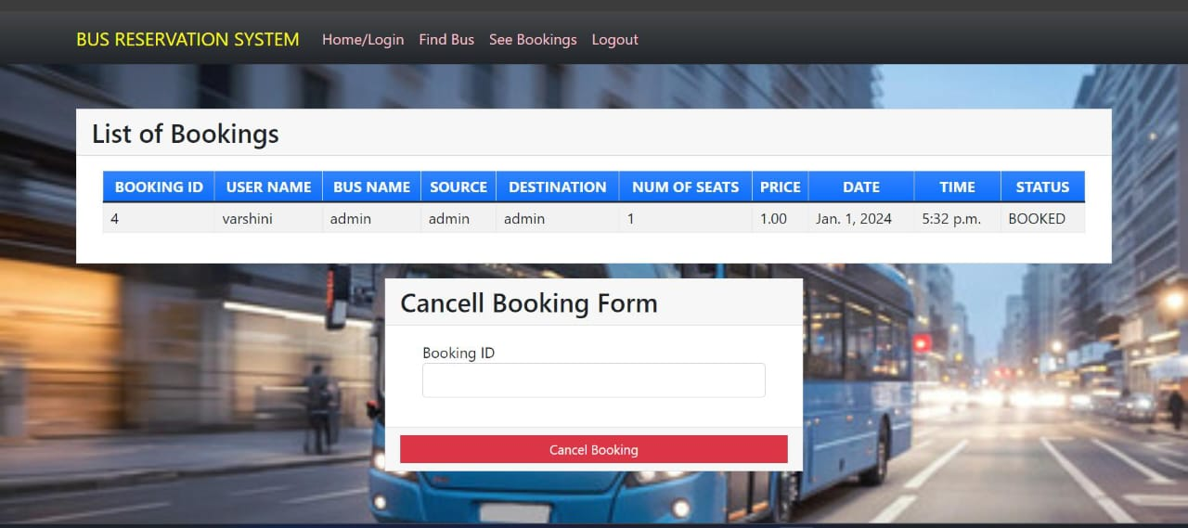
Modelling & Results
Source :

Slide 10
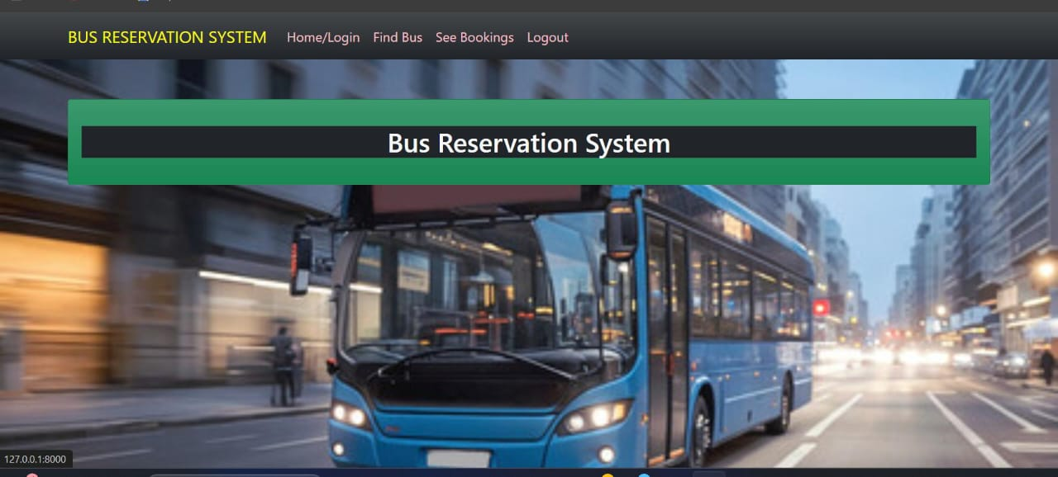
Homepage

Slide 11
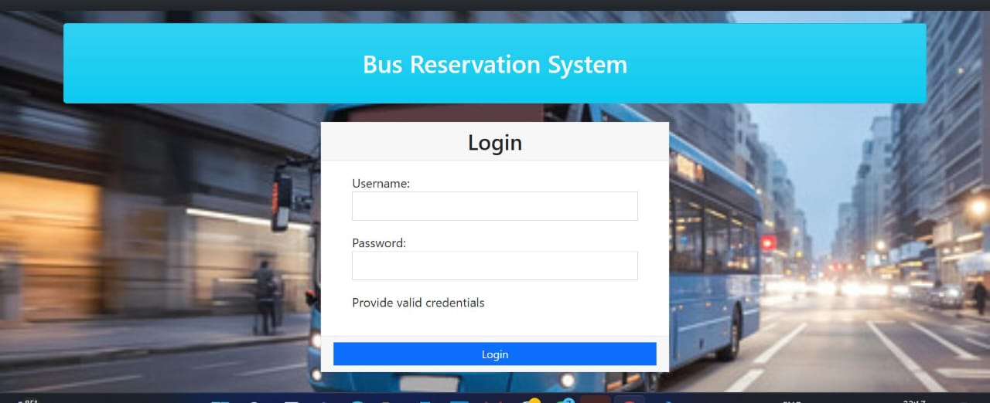
Login

Slide 12
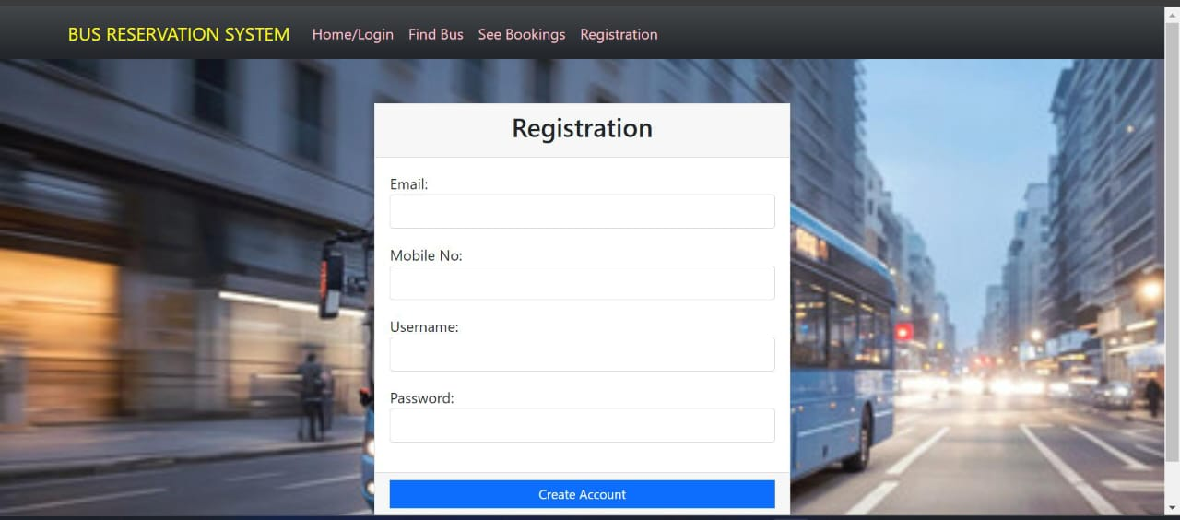
New user/Registration

Slide 13
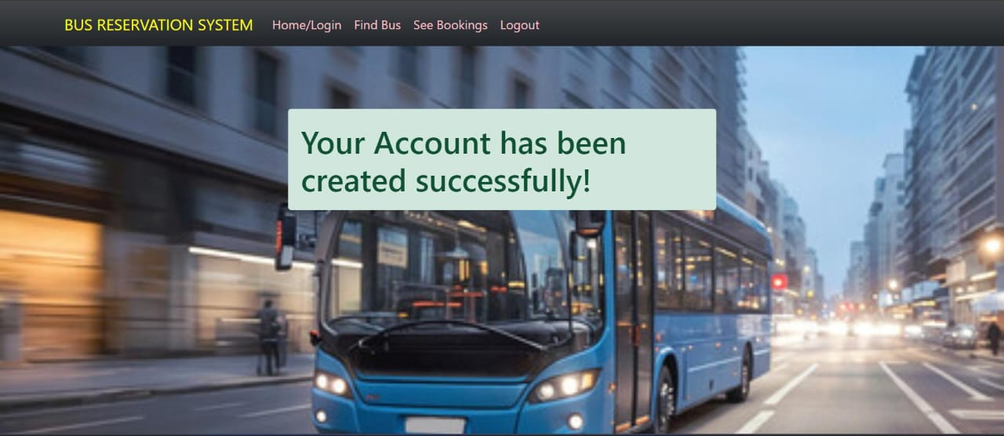
Register successfully:

Slide 14
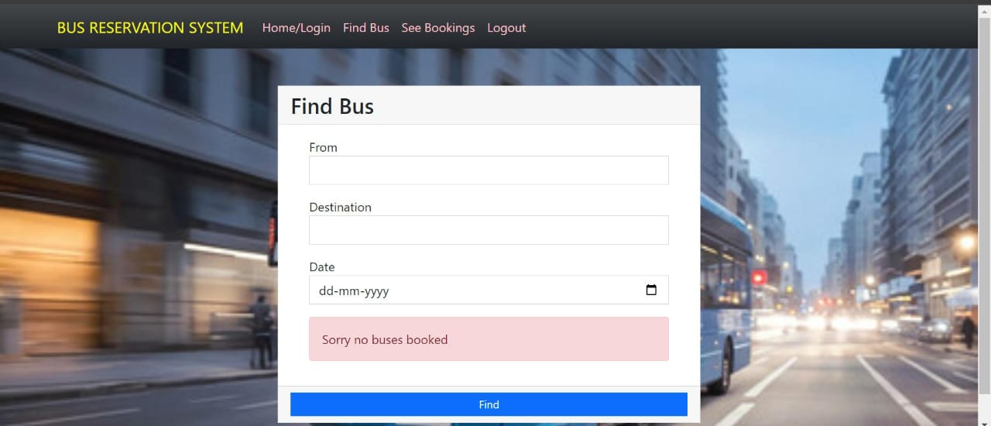
Find bus.

Slide 15
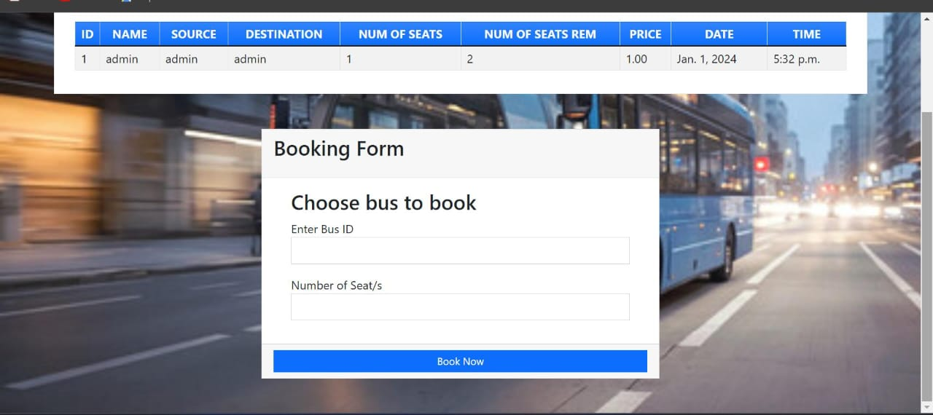
Choose bus.

Slide 16
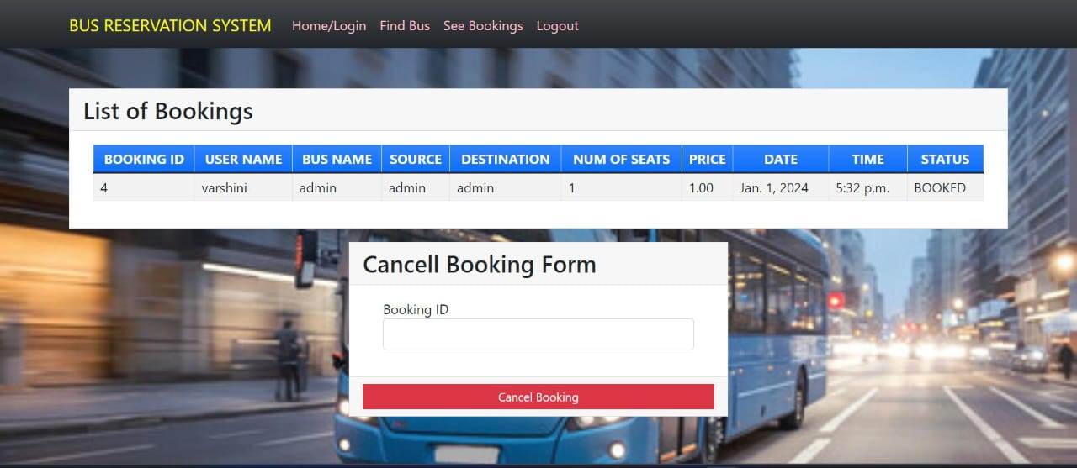
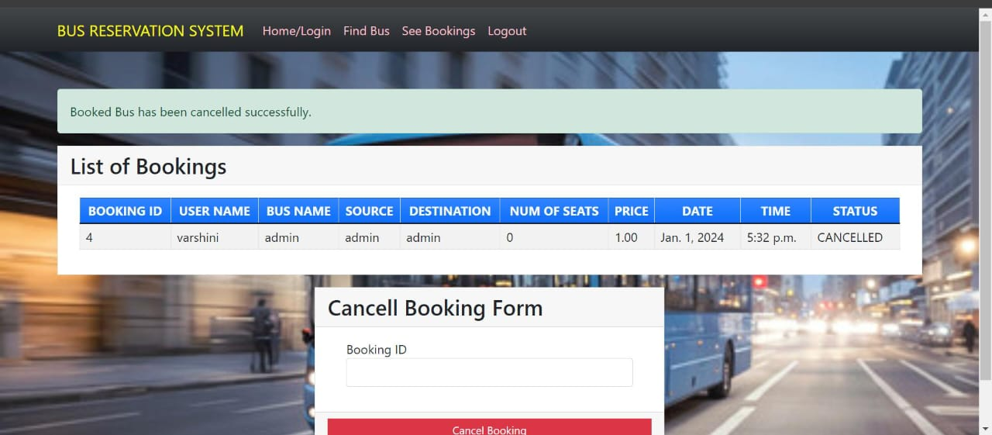
Booking cancel:

Slide 17
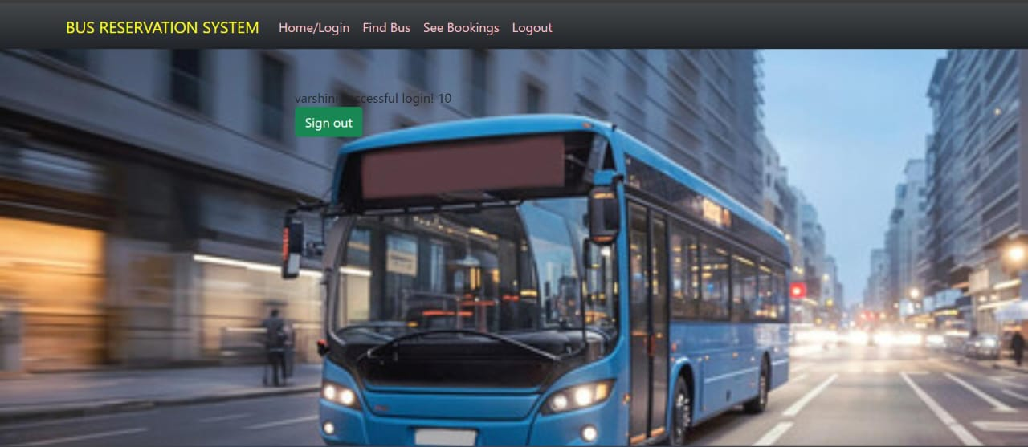
Sign out

Slide 18
Future Enhancements:
Personalized Recommendations: Implement a recommendation engine that suggests events or shows based on users' past booking history, preferences, and behavior. Utilize machine learning algorithms to analyze user data and provide tailored suggestions, enhancing user experience and increasing engagement.
Interactive Seat Selection : Enhance the seat selection process by incorporating interactive seat maps with real-time availability updates. Allow users to preview the view from their selected seats and easily compare options. Additionally, enable users to reserve adjacent seats for group bookings, improving convenience and customer satisfaction.
Integrated Social Features: Integrate social media functionalities to enable users to share their booking plans, invite friends, and see who else is attending the same event. Implement social login options to streamline the registration process and facilitate social interactions within the platform. This not only enhances user engagement but also expands the reach of the website through viral marketing.

Slide 19
Conclusion
Indeed, mobile bus ticketing system (MBTS) is the most noteworthy prospects in the worldtransport system to reduce expenditures and increase traveler's accessibility.
This project will reduce ticket processing flow, reduce usage of paper and allows greater convinces and flexibility to the traveler in cities and allow travel agent to make alterations to the journey.
There are other important issues from the use of this technique such as the mobile ticket cannot be lost or stole non the contrary of sending the ticket by mail also there is a probably of sending it to the wrong address.
MBTS will make customers' lives easier, and can get the service by himself in anytime,anywhere and any devices
Source :

Slide 20
Thank You!
Notes:
Thank You !!

